Slide 1
5b. Description and Classification of Vowels (recap)
The Shape of the Vocal Tract
Unlike consonants, the quality of a vowel cannot be described by a combination of voice, POA and MOA.
Instead, it is determined by the shape of the vocal tract.
Three different criteria are involved in this.
 | Criterion | Range
1 | Height of the tongue (or Closeness) | high, high-mid, mid, low-mid and low
2 | Part of the tongue | front, central and back
3 | Position of the lips | rounded or unrounded

Slide 2
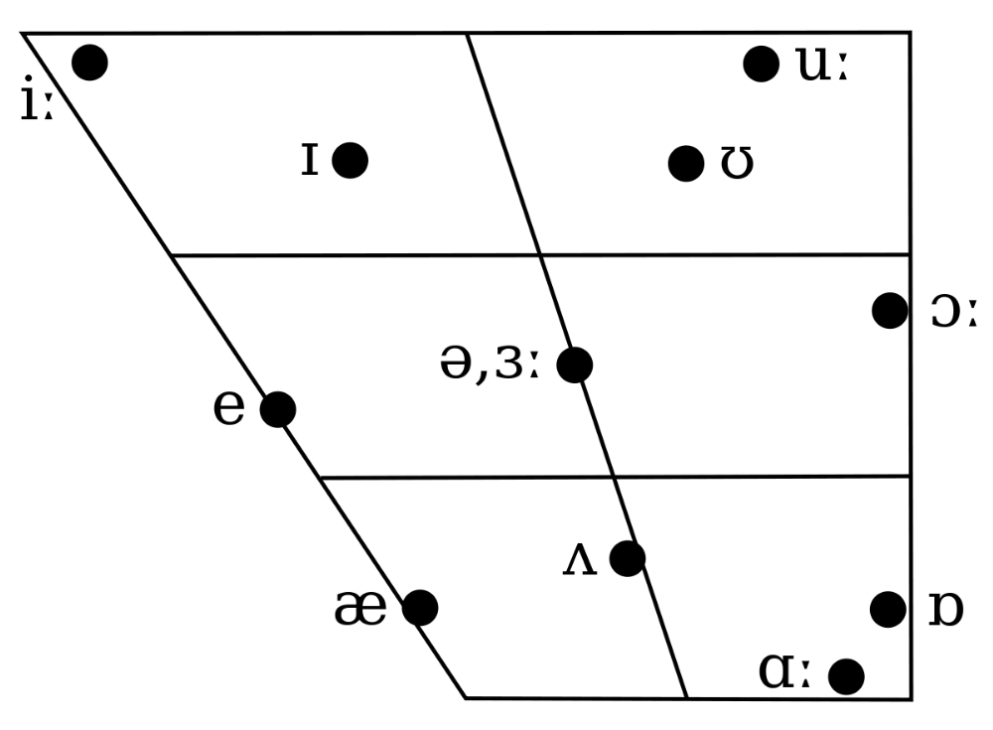
5b. Description and Classification of Vowels (9)
The Vowel Trapezium (Standard Southern British English)
Front
Central
Back
High
Mid-High
Mid
Mid-Low
Source: Æµ§œš¹ https://commons.wikimedia.org/wiki/File:RP_vowel_chart_(monophthongs).gif
Low

Slide 3
5b. Description and Classification of Vowels (10)
Vowel Length or Quantity
Vowels in English and other languages can be long or short.
Length is indicated by the triangular colon diacritic ː placed after the vowel sound.
In Standard Southern British English, the following vowels are long:
[iː], [ɜː], [ɑː], [uː] and [ɔː].

Slide 4
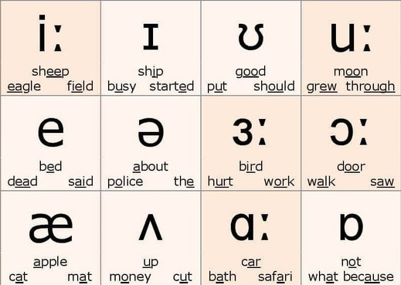
5b. Description and Classification of Vowels (11)
English Vowel Sounds (SSBE) with Examples of Common Spellings
Adapted from: https://albaenglish.co.uk/blog/improve-english-pronunciation-phonemic-chart

Slide 5
5b. Description and Classification of Vowels (12)
Monophthongs and Diphthongs
If the sound of a vowel remains unchanged during its production, it is called a monophthong.
All the vowel sounds considered hitherto have been monophthongs.
If the sound of a vowel changes within a single syllable, then it is called a diphthong (2 sounds).
The change in vowel quality may result from movement of the tongue and/or lips.
The vowels in toy, tie and town ([oi], [ɑi] and [ɑʊ]) are all diphthongs.

Slide 6
5b. Description and Classification of Vowels (13)
Diphthongs
A diphthong moves from a starting position to a finishing position.
Often characterized as fronting, backing or centring.
These terms relate to the character of the finishing vowel sound.
Fronting diphthongs move towards a high (close) front vowel in production.
Backing diphthongs move towards a high (close) back vowel in production.
Centring diphthongs have a final element which is a central vowel.
These are illustrated on the Diphthong Trapezium.

Slide 7
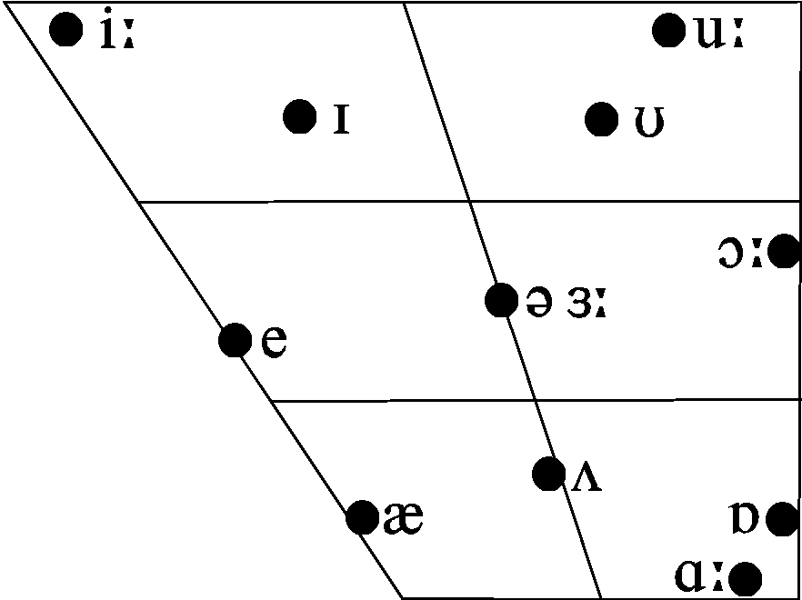
5b. Description and Classification of Vowels (14)
Diphthong Trapezium (Standard Southern British English)
Fronting diphthongs
ɔɪ
Backing diphthongs
eɪ
aɪ
əʊ
aʊ
a
Adapted from: Æµ§œš¹ https://commons.wikimedia.org/wiki/File:RP_vowel_chart_(monophthongs).gif

Slide 8
5b. Description and Classification of Vowels (15)
Diphthong Trapezium (Standard Southern British English)
ʊə
ɪə
eə
Centring diphthongs
a
Adapted from: Æµ§œš¹ https://commons.wikimedia.org/wiki/File:RP_vowel_chart_(monophthongs).gif

Slide 9
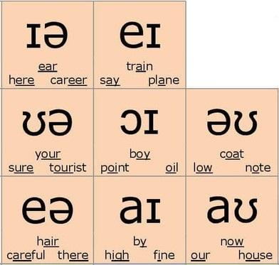
5b. Description and Classification of Vowels (16)
English Dithphongs (SSBE) with Examples of Common Spellings
Adapted from: https://albaenglish.co.uk/blog/improve-english-pronunciation-phonemic-chart

Slide 10
6. Phonetic Transcription (1)
The International Phonetic Alphabet
Most languages do not have a one-to-one correspondence between pronunciation and orthography (spelling).
This means a separate transcription system is needed to represent speech sounds in writing, e.g., in dictionaries and language learning books.
Phonetic transcription provides a 1-to-1 correspondence between sounds and phonetic symbols, which are written within square brackets [ ].
To meet this purpose, the International Phonetic Alphabet (IPA) was developed.
This allows the sounds of any human language to be written down.

Slide 11
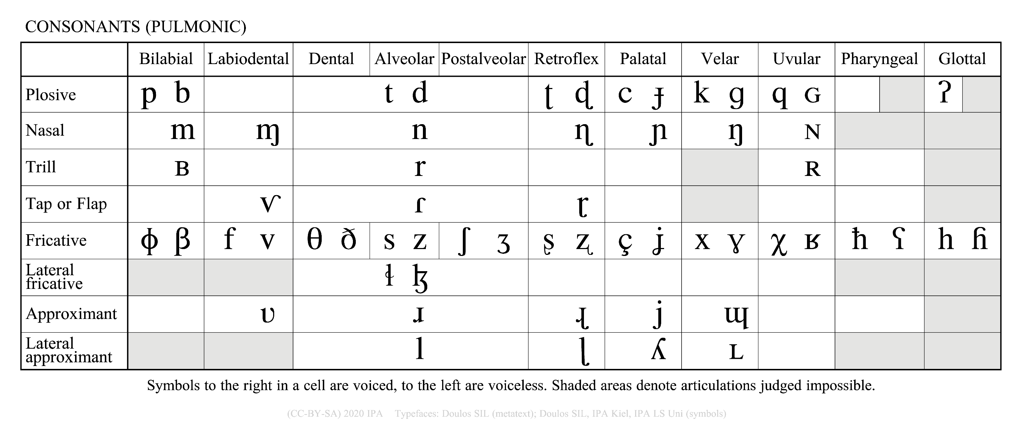
6. Phonetic Transcription (2)
Place of Articulation
The International Phonetic Alphabet (© 2020 IPA)
Manner of Articulation

Slide 12
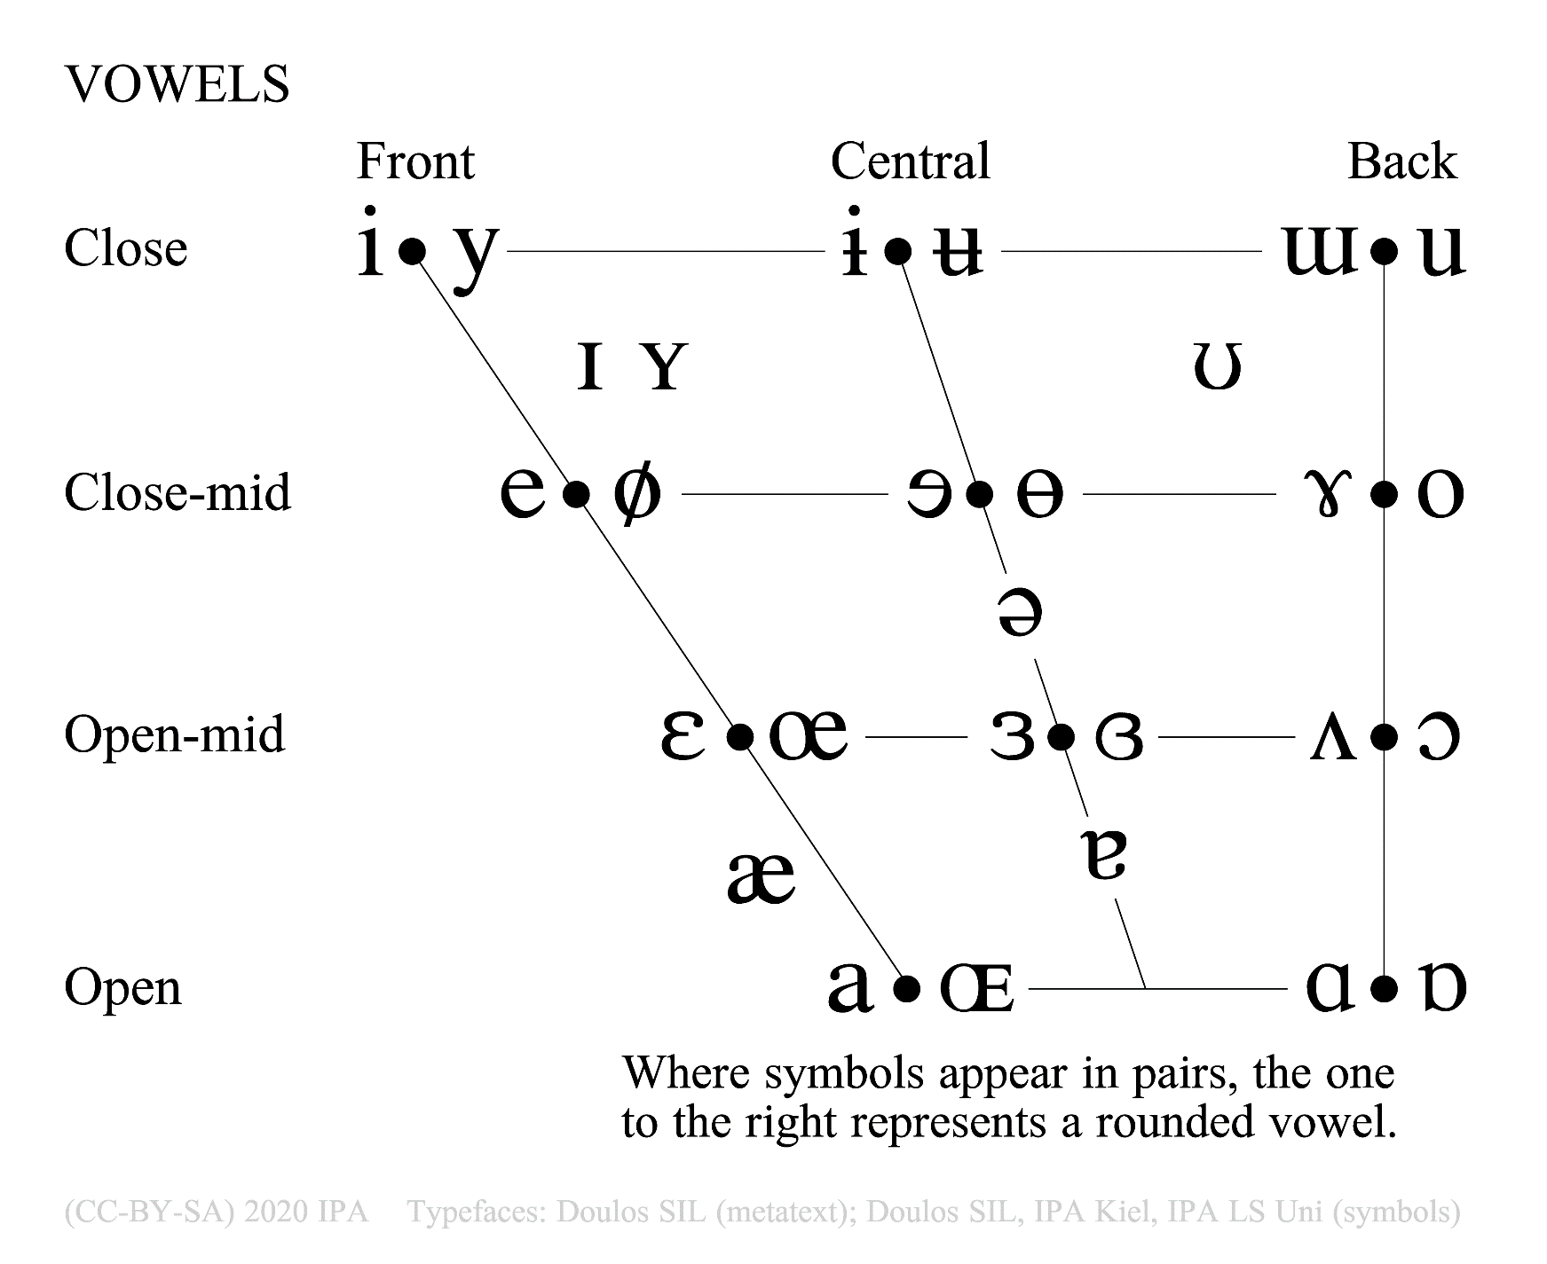
6. Phonetic Transcription (4)
IPA Vowel Chart (© 2020 IPA)

Slide 13
6. Phonetic Transcription (5)
What do all these sounds sound like?
If you are curious, you can listen to various phoneticians saying them here:
https://www.internationalphoneticassociation.org/IPAcharts/inter_chart_2018/IPA_2018.html

Slide 14
6. Phonetic Transcription (6)
Transcribing English
Only a subset of the IPA is needed.
The required subset will depend on the variety of English being transcribed.

Slide 15
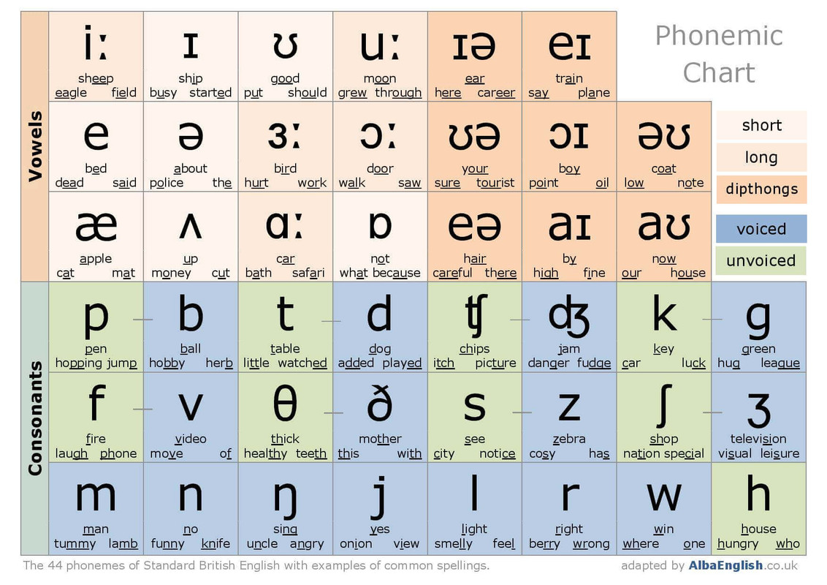
6. Phonetic Transcription (7)
Transcribing Standard Southern British English

Slide 16
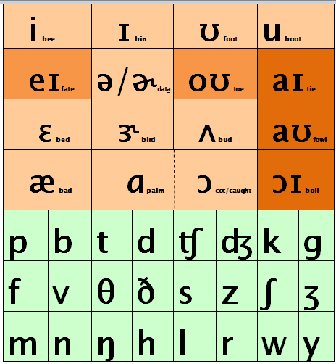
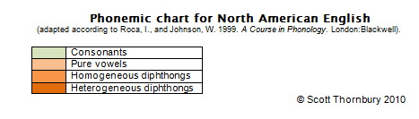
6. Phonetic Transcription (8)
Transcribing General American English

Slide 17
6. Phonetic Transcription (9)
Rhoticity
An English dialect is described as rhotic when the [r] sound is fully distributed (i.e., pronounced) before vowels, consonants and pauses.
Irish, General American and Scottish English are rhotic dialects.
Standard Southern British English and Southern United States English are non-rhotic dialects. [r] is pronounced only when followed by a vowel sound.
 |  | Non-rhotic | Rhotic (Scottish English)
[iə] | beer | [biə] | [biːr]
[eə] | bear | [beə] | [beːr]
[uə] | tour | [tuə] | [tuːr]
[ɔː] | four | [fɔː] | [foːr]
[ɜː] | burn | [bɜːn] | [bʌrn]

Slide 18
6. Phonetic Transcription (10)
Task: Convert the following passage of phonetic script into regular English orthography, noting that capital letters and punctuation are not used in phonetic transcription.
[bʌt ðə riːl hɒrə əmʌŋst spɑɪdəz wəz mɔː lɑɪklɪ tə biː eŋkɑʊntəd ɪn ðə lævətrɪ ɪtself ðɪs wəz ðə redbæk ðə redbæk ɪz meɪnlɪ blæk wɪθ ə skɑːlət strɑɪp weə ɪts spɑɪn wʊd biː ɪf ɪt wɜː ə vɜːtɪbreɪt]
(Clive James, Unreliable Memoirs)
But the real horror amongst spiders was more likely to be encountered in the lavatory. This was the redback. The redback is mainly black with a scarlet stripe where its spine would be if it were a vertebrate.

Slide 19
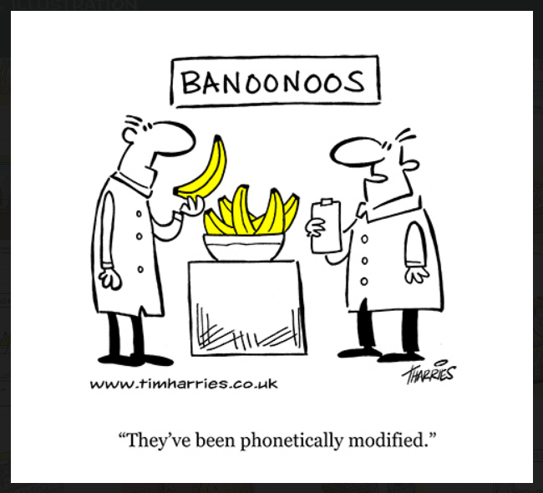
Phonology
http://www.harriescartoons.co.uk/cartoons.html

Slide 20
Overview
What is Phonology?
The Branches of Phonology
Segmental Phonology – sounds: same vs different
Phonological Rules
Connected Speech – coarticulation and its effects

Slide 21
1. What is Phonology?
The Study of the Knowledge of Sounds and their Patterns
Phonology is the study of the systems and patterns of speech sounds in a language.
It is concerned with the unconscious knowledge that an L1 speaker has of the sound patterns of that language.
It deals with the rules that determine what sounds are in a language, how they can combine and the changes that can happen when they combine.

Slide 22
2. The two Branches of Phonology
Phonology
Segmental Phonology
Suprasegmental Phonology
Examines the features of pronunciation that extend over more than one segment: the combination of segments into syllables; patterns of stress, rhythm, tone and intonation.
Examines the function and behaviour of individual sounds (segments) in a language.

Slide 23
3. Segmental Phonology
If an utterance is divided up into individual sounds → identifying segments
Hence the name segmental phonology
Unlike phonetics, it is not concerned with the exact properties of speech sounds but with:
the underlying blueprint of each sound type
how it functions and varies in different physical contexts

Slide 24
3. Sounds: same vs different (1)
Consider these two words: 1) stem & 2) tip
Say the first word with the back of your hand just in front of your mouth.
Do the same for the second word.
Do you perceive any difference in the pronunciation of t for the two words?
The 2nd t is described as aspirated, while the 1st is a voiceless alveolar stop.
Still use the phonetic symbol for the 2nd t , but a diacritic mark is added.
These marks have no sound value but provide more pronunciation detail.
The diacritic for aspiration is a superscript h added to the right of an aspirated consonant: t^{h}

Slide 25
3. Sounds: same vs different (2)
Now consider the pronunciation of t in these words: 1) not yet 2) atlas 3) not now 4) eighth 5) hatpin
Pay attention to the position of your tongue in articulating t.
In each case, compare it with its position for t in stem.
For eighth, try closing your teeth together as you make the t sound.
Your articulation of t should vary for each word.
For (1), your tongue is probably further back towards the hard palate. Here [t] is palatalized and symbolized [t^{j}], where the superscript j is the diacritic for palatalization.
If you say the not yet quickly enough, the sequence [t] [j] → [ʧ]

Slide 26
3. Sounds: same vs different (3)
1) not yet 2) atlas 3) not now 4) eighth 5) hatpin
For (2), there are two alveolar consonants in sequence: a voiceless stop [t] and a lateral approximant [l].
Sequences of consonants with the same POA are called homorganic.
In releasing the stop, you do not move the whole blade of the tongue; only the sides. The centre remains in contact with the alveolar ridge.
Called lateral release and symbolized [t^{l}], where the superscript l is the diacritic for this.

Slide 27
3. Sounds: same vs different (4)
1) not yet 2) atlas 3) not now 4) eighth 5) hatpin
For (3), there is another homorganic sequence of two alveolar consonants: a voiceless stop [t] and a nasal [n].
In releasing the stop, the tongue remains in contact with the alveolar ridge and the air trapped in the oral cavity is released through the nasal cavity.
The velum is raised for the closure of the oral stop but lowered for release of the homorganic nasal.
Called nasalized release and symbolized [t^{n}], where the superscript n is the diacritic for this.

Slide 28
3. Sounds: same vs different (5)
1) not yet 2) atlas 3) not now 4) eighth 5) hatpin
For (4), many speakers have their tongue protruding between their incisors when articulating this t. Others put the tip of their tongue on the back of their incisors.
Called dentalization and symbolized [ t̪], where the diacritic ̪ below the t represents a small incisor tooth.
For (5), your tongue may move towards the alveolar ridge and even touch it, but it’s unlikely you will release the stop.
If you analyse your pronunciation carefully, you’ll notice you make and release the bilabial stop [p] in pin but do not release the stop at the end of hat.
Described as unreleased and transcribed as [t˺]. Indicated by the diacritic ˺

Slide 29
3. Sounds: same vs different (6)
This demonstrates that there are at least seven ways of pronouncing t.
Expanding phonetic framework allows us to describe the extra details.
Question: What do English speakers use these seven types of t for?
Answer: Nothing!
Were you aware of them?
They are all heard as t, and speakers consider them the same.
None of the ‘extra’ phonetic properties involved in recognizing t.

Slide 30
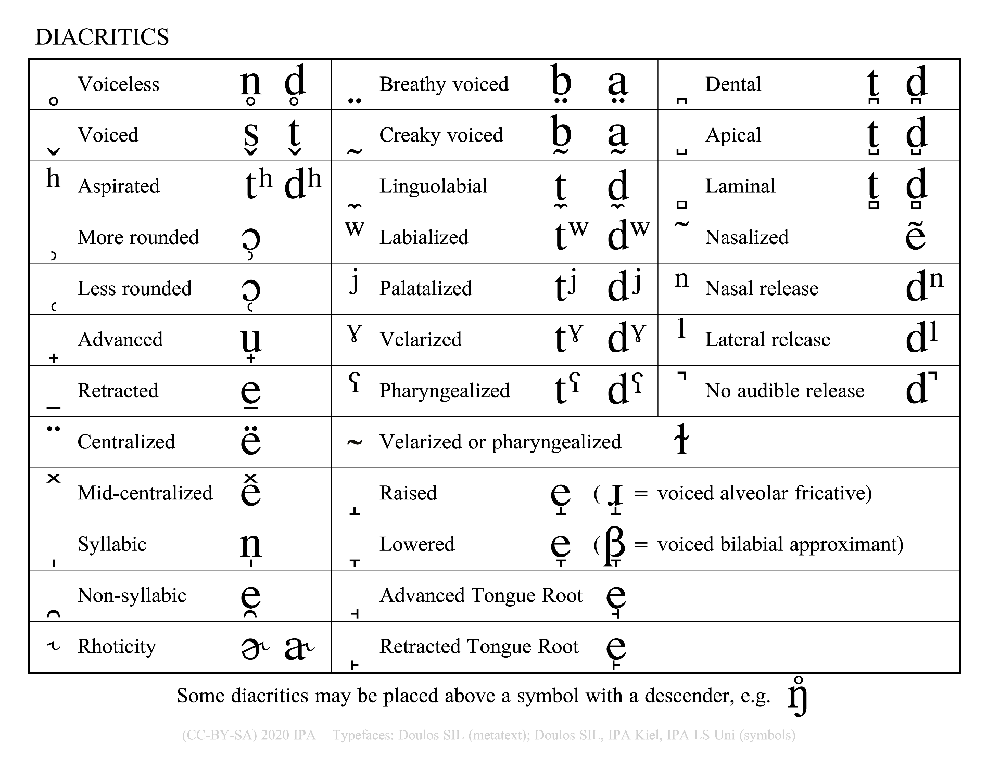
3. Sounds: same vs different (7)
IPA Diacritics Chart

Slide 31
3. Sounds: same vs different (8)
Task:
Consider the word tip. Try replacing the initial voiceless alveolar plosive with other consonant sounds.
E.g.,
[p] voiceless bilabial plosive
[d] voiced alveolar plosive
[n] voiced alveolar nasal
[s] voiceless alveolar fricative
[z] voiced alveolar fricative
[l] voiced alveolar lateral approximant
[w] voiced labio-velar approximant
Each time → different word and different meanings
In contrast, the phonetic varieties of t do not create different words.

Slide 32
3. Sounds: same vs different (9)
Two sets of phonetic properties
Phonetic properties such as aspiration, dentalization and palatization are not distinctive in English.
They are automatic and beyond the speaker’s control.
However, properties such as voiced, voiceless; bilabial, dental, alveolar; plosive, fricative and approximant are within the control of the speaker.
They are used to distinguish between sounds and words.
Set 1 are called non-distinctive; Set 2 are called distinctive (information bearing)

Slide 33
3. Sounds: same vs different (10)
Phonemes and Allophones
The set of sounds that speakers use to distinguish one word from another are called phonemes.
Their status is indicated by enclosing them in slanted brackets, e.g., /t/and /d/.
Sounds that have one or more non-distinctive properties are called allophones from Greek allos = other (variant forms of a phoneme)
These phonetic variants are indicated by enclosing them in square brackets, e.g., [t^{h}] and [d˺].

Slide 34
3. Sounds: same vs different (11)
Phonemes and Allophones
The set of properties that are distinctive are not constant across the world’s languages.
For example, aspiration is non-distinctive in English, but, distinctive in Korean and Thai.
Speakers of these languages hear a difference between [t^{h}] and [t].
In Korean and Thai, voiceless aspirated plosives are phonemes: /p^{h}/, /t^{h}/, /k^{h}/ whereas in English they are allophones.

Slide 35
3. Sounds: same vs different (12)
Phonemes and Allophones
Level Unit
phonemic (phonological) /t/ phoneme
allophonic (phonetic) [t^{h}] [t^{j}] [t^{l}] [ t̪] [t^{n}] [t˺] allophone

Slide 36
3. Sounds: same vs different (13)
Identifying Phonemes
The minimal pair test is used to determine the phonological importance of a sound.
Involves substituting sounds in a word that differs by only one sound.
Any two words that differ by only one sound are termed a minimal pair.
For example, take the word pin, /pɪn/. Substitute other consonant sounds for /p/. Which ones make an English word?
/b t d k f θ s ʃ ʧ ʤ w l/ all create other English words:
bin, tin, din, kin, fin, thin, sin, shin, chin, gin, win and Lynn

Slide 37
3. Sounds: same vs different (14)
Identifying Phonemes
The minimal pair test is based on the notion of minimal contrast.
Sounds that contrast in the same position in a frame, e.g., [_ɪn], are said to be in contrastive distribution.
Here distribution refers to a ‘position in a sequence’.
The allophones of /t/: [t^{h}] [t^{j}] [t^{l}] [ t̪] [t^{n}] [t˺] occur in mutually exclusive environments, e.g., [t^{l}] only before a lateral sound; [ t̪] only before a dental.
This means they cannot contrast → complementary distribution

Slide 38
4. Phonological Rules (1)
Allophonic Rules
Allophones are the predictable realizations of phonemes.
Therefore, their occurrence can be expressed as a rule.
Rules that link an abstract phoneme to its allophonic realizations are called allophonic rules:
(Context)
For example: /t/ → [t^{j}] / ____ j
(Input) (Output) (Conditioning factor)
 | INPUT | OUTPUT
Phonemic Form → | Acted on by → | Phonetic Representation
(Abstract Unit) | Allophonic Rule(s) | (What speakers produce)

Slide 39
4. Phonological Rules (2)
Allophonic Rules
(Context)
/t/ → [t^{j}] / ____ j
(Input) (Output) (Conditioning factor)
This rule tells us, “the phoneme /t/ is realized as its palatized allophone when it occurs before a palatal approximant, j”

Slide 40
4. Phonological Rules (3)
Allophonic Rules
More generally, the process part of the rule is expressed: /X/ → [Y] /
“Phoneme X is realized as allophone Y”
For the context part of the rule, there are three basic possibilities:
Conditioning factor follows input phoneme: /____F
Conditioning factor precedes input phoneme: / F____
Input phoneme occurs between two conditioning factors: / F₁ ____F₂

Slide 41

5. Connected Speech (1)
Co-articulation is the way individual sounds are joined together smoothly into utterances.
We write the pronunciation of ‘happy’ as /hæpi/
NOT /h/ /æ/ /p/ /i/
Chain
public domain image, https://openclipart.org/artist/oksmith

Slide 42
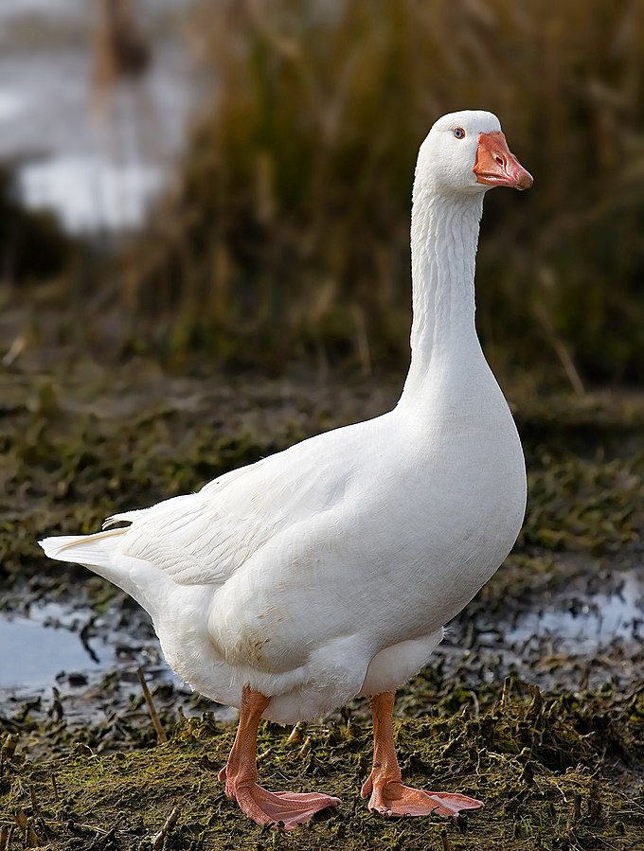
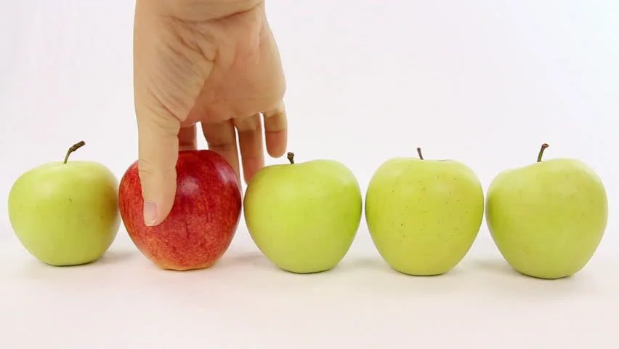
5. Connected Speech (2)
Sounds may change when they are pronounced in combination.
For example: what happens to the vowel sound /u:/ in the words below?
goose
choose
Such changes are known as assimilation.
https://commons.wikimedia.org/wiki/File:Domestic_Goose.jpg

Slide 43
5. Connected Speech (3)
Assimilation is the process where one segment becomes more like (or identical to) another segment, or two segments become more like each other.
Consider happen and input
Careful pronunciation → [hæpən] [ɪnpʊt]
More natural → [hæpm] [ɪmpʊt]
The alveolar nasal /n/ becomes more like the bilabial stop /p/ by becoming a bilabial nasal /m/
The bilabial stop (source) triggers the assimilation, and the bilabial nasal (target) is the segment that changes.

Slide 44
5. Connected Speech (4)
The relative positions of the source and target lead to different directions of assimilation:
[hæpən] → progressive (or perseverative) assimilation
/n/ → [m] / p^{(source)} ____ ^{(target)}
[ɪnpʊt] → regressive (or anticipatory) assimilation
/n/ → [m] / ____^{(target)} p^{(source)}

Slide 45
5. Connected Speech (5)
Types of Assimilation: place, voice, nasalization, and lip attitude
Place
[hæpm] and [ɪmpʊt]: alveolar nasal assimilated to a bilabial stop.
The dentalized, lateralized and palatalized allophones [t^{j}], [t^{l}] and [ t̪] all examples of assimilation of place.
Note for input the assimilation /n/ → [m] does not change the spelling of the word.
Spelling ≠ pronunciation in English!

Slide 46
5. Connected Speech (6)
Types of Assimilation: place, voice, nasalization, and lip attitude
Voice
A sound becomes more like its neighbours by ‘agreeing’ in voice.
Voiceless sounds → voiced [called voicing]
Voiced sounds → voiceless (partially or fully) [called devoicing]

Slide 47
5. Connected Speech (7)
Types of Assimilation: place, voice, nasalization, and lip attitude
Voice
Task Part 1: transcribe the following, paying attention to pronunciation and not the spelling:
town’s, book’s, people’s, Pat’s
[taʊnz bʊks piːpəlz pæts]
If /n/ and /l/ are considered the sources, and the target is /s/ → progressive assimilation of voice.

Slide 48
5. Connected Speech (8)
Assimilation of Voice
If we transcribe the following phonemically,
small, slap, slush, trap, class, crush
we’d get:
/smɔːl slæp slʌʃ træp klɑːs kræʃ/
However, recordings show the 2nd segment is either voiceless or partially voiced:
[sm̥ɔːl sl̥æp sl̥ʌʃ tr̥æp kl̥ɑːs kr̥æʃ] [˳] = voiced sound devoiced
Progressive assimilation of voice

Slide 49
5. Connected Speech (9)
Assimilation of Voice: Vowels
Short vowels /ɪ e æ ʌ ɒ ʊ/
Other monophthongs and diphthongs are long.
Precise length of a vowel depends on its environment, c.f., goose vs choose
Vowels followed by voiceless consonants are shorter than those followed by a voiced consonant or in word-final position.
Compare
[biˑt biːd biː]
beat | bead | bee
bit | bid
base | beige | bay
bet | bed

Slide 50
5. Connected Speech (10)
Types of Assimilation: place, voice, nasalization, and lip attitude
Nasalization
Only 3 nasal stops in English: /m n ŋ/
Nasalization occurs when the velum is lowered during the production of a segment that isn’t normally nasal.
In English, commonly found as regressive nasalization of vowels preceding a nasal stop:
congress /kɒŋgres/ → [k^{h}ɒ̃ŋgres]
Rule: V → Ṽ___ N, where V = any vowel; N = any nasal; [~] = nasalization

Slide 51
5. Connected Speech (11)
Types of Assimilation: place, voice, nasalization, and lip attitude
Lip Attitude
Refers to the position of the lip during articulation of a sound.
The lip rounding for the articulation of rounded back vowels may spread to adjacent consonants → labilalization, symbolized [^{w}]
Contrast saying keel and cool while looking in a mirror.
/kʊl/ cool [k^{wh}ʊl]

Slide 52
5. Connected Speech (12)
Types of Assimilation: place, voice, nasalization, and lip attitude
Fusion
Occurs when 2 segments assimilate to each other creating a third distinct segment combining the properties of the 2 assimilating segments.
In careful speech, caught you and would you are realized as
[k^{h}ɔːt juː] and [wʊd juː]
Whereas in normal (rapid) conversation [k^{h}ɔːt juː] and [wʊd juː] →
[k^{h}ɔːʧə] and [wʊʤə]
The alveolar stop and following palatal approximant fuse → voiceless and voiced post-alveolar affricates [ʧ] and [ʤ], respectively.

Slide 53
5. Connected Speech (13)
Other Processes Affecting Segments in Context
Elision
Task: Say these words to yourself out loud; then transcribe what you say:
handsome, windmill, handkerchief, mostly, kindness, attempts
You probably found you omitted some consonant sounds:
/d/ in handsome, windmill, handkerchief, and kindness
/t/ in mostly and attempts
The deletion of segments is called elision
Common in less formal and more casual speech styles, esp. /t/, /d/ and /θ/

Slide 54
5. Connected Speech (14)
Other Processes Affecting Segments in Context
Elision
Can occur across word boundaries:
thousand points /θaʊznd pɒɪnts/ → [θaʊzn pɒɪnts]
west coast /west kəʊst/ → [wes kəʊst]
In some cases, elision of a segment allows assimilation to take place:
handbag /hændbæg/ → [hænbæg] → [hæmbæg]
Vowels can also be elided: I am → I’m; She is → She’s; do not → don’t; police → [pliːs]; geography → [ʤɒgrəfɪ]

Slide 55
5. Connected Speech (15)
Other Processes Affecting Segments in Context
Insertion
Called epenthesis
Possible for both consonants and vowels:
In some dialects, schwa [ə] is inserted between 2 consonants, e.g.,
[fɪləm] film [æθəliːt] athlete [ɑːrəm] arm
Consonant epenthesis between nasal-fricative and nasal-stop sequences (e.g., /ns/ and /mt/):
[mɪnts] mince/mints [drempt] dreamt

Slide 56
5. Connected Speech (16)
Other Processes Affecting Segments in Context
/r/ Insertion
In non-rhotic dialects, /r/ is often inserted when one word end with the vowels /ə/, /ɑː/ or /ɔː/ and the next begins with any vowel sound:
media exploitation [əre] media are [ərɑː]
law and order [ɔːrə] saw it [ɔːrɪ]
Eases the transition between the vowel sounds.
Much less common for speakers of rhotic dialects.

Slide 57
5. Connected Speech (17)
Other Processes Affecting Segments in Context
/j/ Insertion
For words ending with /iː/ or diphthongs /eɪ/, /aɪ/ or /ɒɪ/, speakers often insert a /j/ to ease the transition to a following vowel sound:
I agree [aɪ jəgriː] I am [aɪ jæm] they are [eɪ jɑː]
/w/ Insertion
For words ending with /uː/ or diphthongs /əʊ/ or /aʊ/, speakers often insert a /w/ to ease the transition to a following vowel sound:
Go on [gəʊ wɒn] Who is [huː wɪz] You are [juː wɑː]

Slide 58
5. Connected Speech (18)
Other Processes Affecting Segments in Context
Catenation
When a word ends with a consonant sound, and the next one begins with a vowel sound, the two sounds are linked together without a pause in between them.
For example, an + apple → 'anapple’ this + afternoon → ‘thisafternoon’
Could I have a look at one of the watches in the window? →
Could ͜I hav ͜a look ͜at on ͜of the watches ͜in the window?

Slide 59

5. Connected Speech (19)
Task
If we say these phrases out loud, we can work out what features of connected speech are occurring.
One apple
Two apples
Three apples
Four apples
Five apples

Slide 60
5. Connected Speech (20)
Task
What features of connected speech are evident in this sentence (when it is spoken)?
Have you asked the photographer what he thinks?
Assimilation /θɪŋks/
Elision /ɑ:st/ not /ɑ:skt/
Intrusion /ju:wɑ:st/
Linking/catenation /wɒti:/
Weak forms /ðə/

